Slide 1
National Literacy Learning Progression
201024
Notes:
This presentation adds detail about the National Literacy Learning Progression. It is useful to have seen or presented the ‘National Literacy and Numeracy Learning Progressions: Overview’ presentation before engaging with this resource.
The following slides and notes provide information about Version 3 of the National Literacy Learning Progression, a resource available on the Australian Curriculum website that teachers and schools may choose to use.
Website: www.australiancurriculum.edu.au/resources/national-literacy-and-numeracy-learning-progressions

Slide 2
The Australian Curriculum
The Australian Curriculum: English has a central role in the development of literacy.
In addition, all Australian Curriculum learning areas require students to apply and develop
discipline-specific literacy knowledge and skills.
Notes:
Literacy is explicit and foregrounded in the English curriculum more than in other learning areas. In addition, all Australian Curriculum learning areas require the application and development of discipline-specific literacy skills.
‘Literacy encompasses the knowledge and skills students need to access, understand, analyse and evaluate information, make meaning, express thoughts and emotions, present ideas and opinions, interact with others and participate in activities at school and in their lives beyond school. Success in any learning area depends on being able to use the significant, identifiable and distinctive literacy that is important for learning and representative of the content of that learning area.’ www.australiancurriculum.edu.au/f-10-curriculum/general-capabilities/literacy

Slide 3

Relationship: Learning areas and resources
Australian Curriculum Learning area | General capability: Literacy Literacy continuum
 | National Literacy Learning Progression
Notes:
The Australian Curriculum offers multiple opportunities, across learning areas, to support students’ development of literacy. This slide identifies the connections between the Australian Curriculum and other resources.
The learning areas’ content descriptions specify a sequence of development of knowledge, understanding and skills.
For each learning area, the literacy continuum identifies opportunities to build literacy into teaching and learning. The suggestions for literacy learning are identified by a symbol underneath the content descriptions that can be clicked to reveal a drop-down list of relevant literacy teaching and learning opportunities. The literacy continuum describes what can reasonably be expected of students at particular year levels.
The National Literacy Learning Progression describes, in detail, the steps of literacy development. These steps are not organised by learning area, content, year levels or stages of schooling.

Slide 4
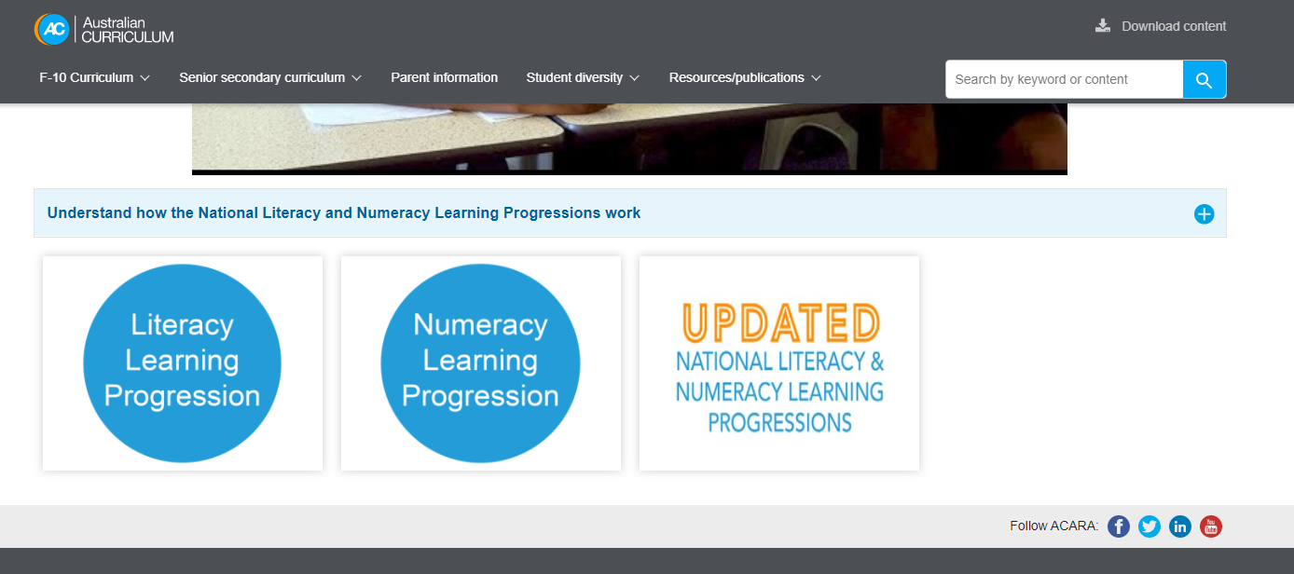
Where to find the Literacy Learning Progression
Notes:
Clip source: https://australiancurriculum.edu.au/resources/national-literacy-and-numeracy-learning-progressions
On the National Literacy and Numeracy Learning Progressions page, you will find links to both Version 2 and the newly refined Version 3 of the progressions. This allows interested schools and jurisdictions to access Version 3 and also provides a transition time for those currently using Version 2 of the progressions.

Slide 5
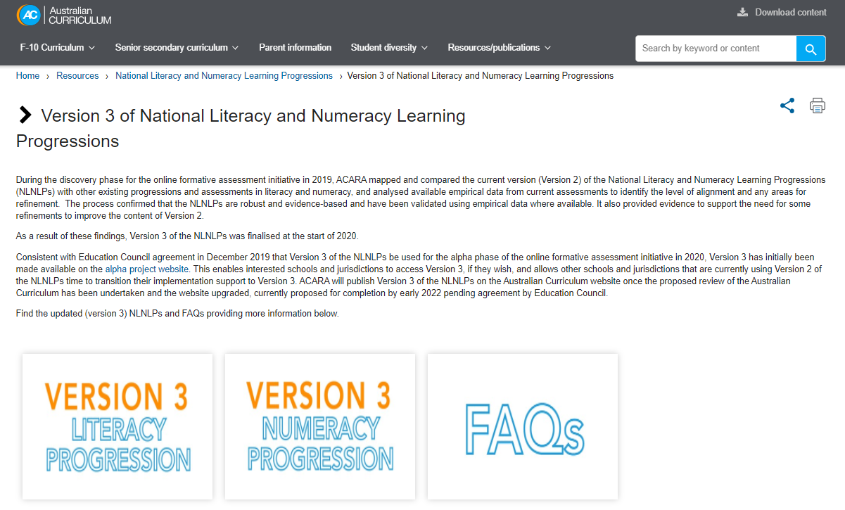
Version 3 of National Literacy and Numeracy Learning Progressions
Notes:
Clip source: www.australiancurriculum.edu.au/resources/national-literacy-and-numeracy-learning-progressions/version-3-of-national-literacy-and-numeracy-learning-progressions
Version 3 of the National Literacy and Numeracy Learning Progressions was finalised at the start of 2020 and is the basis of this presentation.
A frequently asked questions document is also available for additional information.

Slide 6
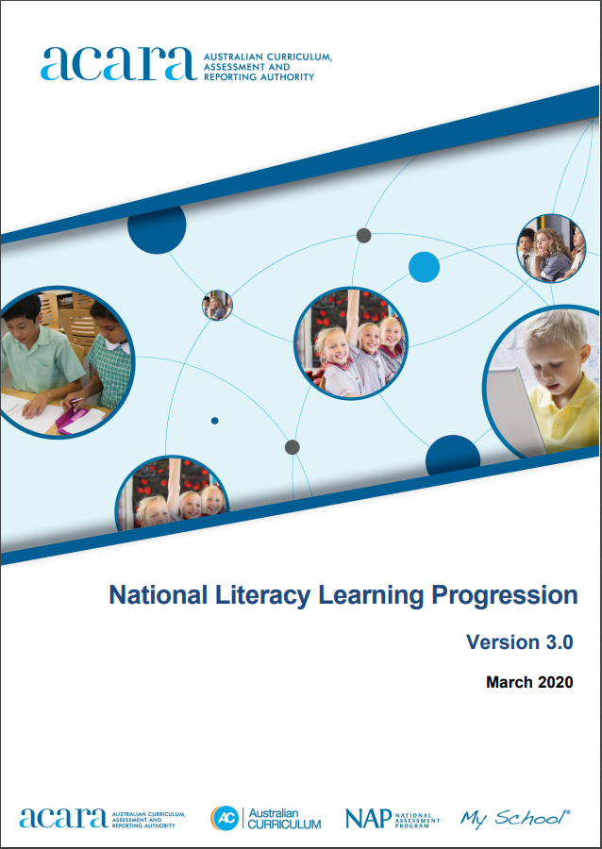
National Literacy Learning Progression Version 3.0
Version 3 refinements include:
enhanced detail of sub-element definitions
systematic representation of skill development across levels
consistent terminology
consistent sequence of indicators across levels
greater clarity within indicators and examples.
Notes:
Clip source: www.lpofai.edu.au/media/kw2lslug/national-literacy-learning-progression-v3-for-publication.pdf
Version 3 of the National Literacy Learning Progression is currently available as a PDF.
It is planned that Version 3 of the progressions will be incorporated into the Australian Curriculum website upgrade, once the Australian Curriculum review is finalised.
Version 3 refinements include:
enhanced detail of sub-element definitions
systematic representation of skill development across levels
consistent terminology
consistent sequence of indicators across levels
greater clarity within indicators and examples.

Slide 7
Using the Literacy Learning Progression
The progression is a tool to:
locate each student’s current level of literacy development on the learning progression
identify the next steps for literacy learning
develop a shared understanding of literacy development.

Slide 8
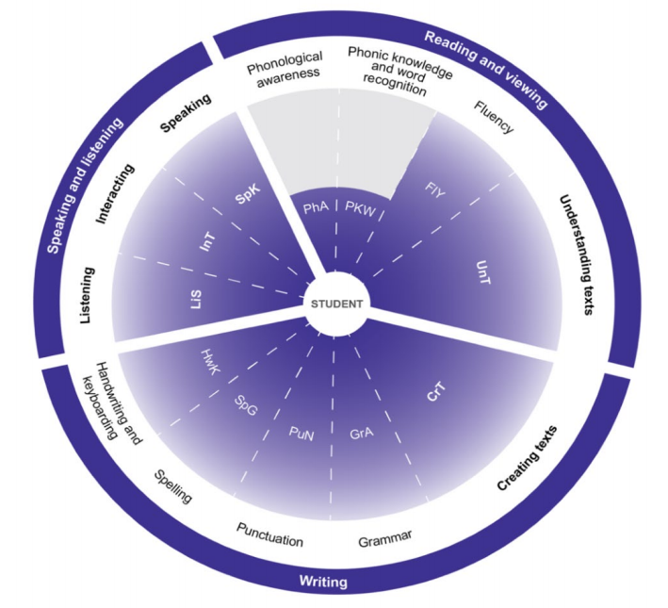
Structure: Literacy Learning Progression
Elements
Levels
Sub-elements
Credit: National Literacy Learning Progression
Notes:
Clip source: www.lpofai.edu.au/media/kw2lslug/national-literacy-learning-progression-v3-for-publication.pdf
There are common structural and organisational features in the National Literacy and Numeracy Learning Progressions. The largest structural unit is an element, and there are three in the Literacy Learning Progression: reading and viewing, writing, and speaking and listening. These elements are further divided into 12 sub-elements, which are populated with indicators. Indicators within a sub-element are grouped together to form developmental levels.
This graphic shows the structure of the Literacy Learning Progression. It can be found online in the National Literacy Learning Progression PDF under the heading: How is the National Literacy Learning Progression structured? (p. 7)

Slide 9
Literacy elements and sub-elements
Element | Sub-element
Speaking and listening | Listening Interacting Speaking
Reading and viewing | Understanding texts Phonological awareness Phonic knowledge and word recognition Fluency
Writing | Creating texts Handwriting and keyboarding Spelling Punctuation Grammar
Notes:
This is a table of the elements (which provide a holistic view of literacy) and the sub-elements (which identify important components of knowledge, understanding and skills).
Five of the sub-elements are overarching. These are shown in bold:
Listening
Interacting
Speaking
Understanding texts
Creating texts.

Slide 10
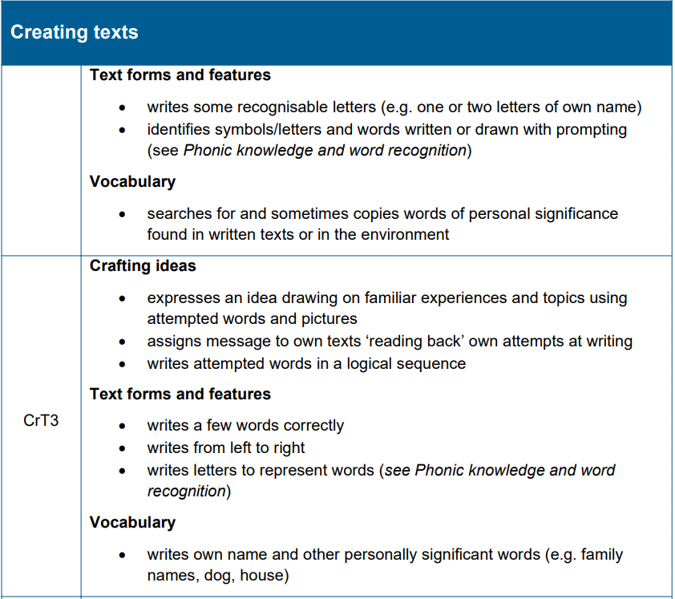
Example
Element: Writing
Sub-element
Indicators
Sub-heading
Level
Credit: National Literacy Learning Progression
Notes:
Clip source: www.lpofai.edu.au/media/kw2lslug/national-literacy-learning-progression-v3-for-publication.pdf
This slide provides an example of the Literacy Learning Progression.
The example sits within the element: Writing.
It is drawn from the sub-element: Creating texts.
Sub-element levels are identified by initials of the sub-element name followed by ascending numbers.
Indicators within a level are non-hierarchical.
Sub-headings are used to group related indicators.
As the presentation progresses, annotations appear.

Slide 11
Using the Literacy Learning Progression
When using the progression to identify student development note that:
teachers make a holistic judgment when placing students on a level
teachers identify next steps in literacy progression
indicators at each level are neither hierarchical nor prescriptive
the progression is not designed to be used as a checklist.
Notes:
Teachers are encouraged to draw on a diverse range of learning experiences to make holistic judgments about students’ levels in the Literacy Learning Progression. Teachers may consider the elements and sub-elements in determining what steps should be taken next to support a student’s literacy progression.

Slide 12
Where to now?
QCAA advises that the National Literacy and Numeracy Learning Progressions are a resource schools may choose to use.
Schools are best placed to decide how to use the learning progressions, with advice from their sector.
The National Literacy Learning Progression is on
the Australian Curriculum website under the ‘Resources/publications’ tab:
https://australiancurriculum.edu.au/resources/national-literacy-and-numeracy-learning-progressions

Slide 13

Acknowledgments
© State of Queensland (QCAA) 2020
Licence: https://creativecommons.org/licenses/by/4.0 | Copyright notice: www.qcaa.qld.edu.au/copyright — lists the full terms and conditions, which specify certain exceptions to the licence. |
Attribution: ‘© State of Queensland (QCAA) 2020— please include the link to our copyright notice.
Other copyright material in this publication is listed below:
Content from ACARA, including the National Literacy and Numeracy Learning Progressions, is © ACARA 2010–2020, licensed under CC BY 4.0. For the latest information and additional terms of use, please check the Australian Curriculum website and its copyright notice.

