Slide 1
National Literacy and Numeracy Learning Progressions: Overview
201023
Notes:
This presentation offers an overview of the Australian Curriculum: National Literacy and Numeracy Learning Progressions. It should be used in conjunction with the presentations on the National Literacy Learning Progression and the National Numeracy Learning Progression.
These presentations can be used in your organisation as the basis for professional learning about the National Literacy and Numeracy Learning Progressions.
Website: www.australiancurriculum.edu.au/resources/national-literacy-and-numeracy-learning-progressions

Slide 2
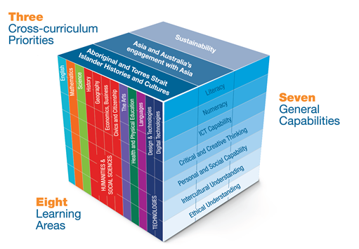
Current landscape for Australian Curriculum
The Australian Curriculum provides:
Source: The three dimensions of the Australian Curriculum by ACARA is licensed CC BY 4.0.
Notes:
Clip source: www.australiancurriculum.edu.au/f-10-curriculum/structure
The Australian Curriculum is the focus for planning, teaching, learning and assessment in Queensland. This image represents the three-dimensional nature of the Australian Curriculum and the value of the interrelationships between the knowledge, skills and understanding in the eight learning areas, the seven general capabilities and the three cross-curriculum priorities. These support students to learn and create, be active and be informed.
The eight learning areas (English, Mathematics, Science, Humanities and Social Sciences, The Arts, Health and Physical Education, Languages, and Technologies) provide the content and achievement standards from Foundation (or Prep) to Year 10.
There are seven general capabilities addressed through the content of the learning areas, which are divided into two groups:
capabilities that support students to be successful learners — including literacy, numeracy, information and communication technology capability, and critical and creative thinking
capabilities that develop ways of being, behaving and learning to live with others — including personal and social capability, ethical understanding, and intercultural understanding.

Slide 3
Literacy in the Australian Curriculum
The Australian Curriculum: English has a central role in the development of literacy.
In addition, all Australian Curriculum learning areas require students to apply and develop
discipline-specific literacy knowledge and skills.
Notes:
Literacy is explicit and foregrounded in the English curriculum more than in other learning areas. In addition, all Australian Curriculum learning areas require the application and development of discipline-specific literacy skills.
‘Literacy encompasses the knowledge and skills students need to access, understand, analyse and evaluate information, make meaning, express thoughts and emotions, present ideas and opinions, interact with others and participate in activities at school and in their lives beyond school. Success in any learning area depends on being able to use the significant, identifiable and distinctive literacy that is important for learning and representative of the content of that learning area.’ www.australiancurriculum.edu.au/f-10-curriculum/general-capabilities/literacy

Slide 4
Numeracy in the Australian Curriculum
The Australian Curriculum: Mathematics has a central role in the development of numeracy.
In addition, all Australian Curriculum learning areas require students to apply and develop
discipline-specific numeracy knowledge and skills.
Notes:
Numeracy is explicit and foregrounded in the Mathematics curriculum more than in other learning areas. The Mathematics curriculum provides opportunities to apply mathematical understanding and skills in context, in other learning areas and in real-world contexts. In addition, all Australian Curriculum learning areas require the application and development of discipline-specific numeracy skills.
‘In the Australian Curriculum, students become numerate as they develop the knowledge and skills to use mathematics confidently across other learning areas at school and in their lives more broadly. Numeracy encompasses the knowledge, skills, behaviours and dispositions that students need to use mathematics in a wide range of situations. It involves students recognising and understanding the role of mathematics in the world and having the dispositions and capacities to use mathematical knowledge and skills purposefully.’ www.australiancurriculum.edu.au/f-10-curriculum/general-capabilities/numeracy

Slide 5
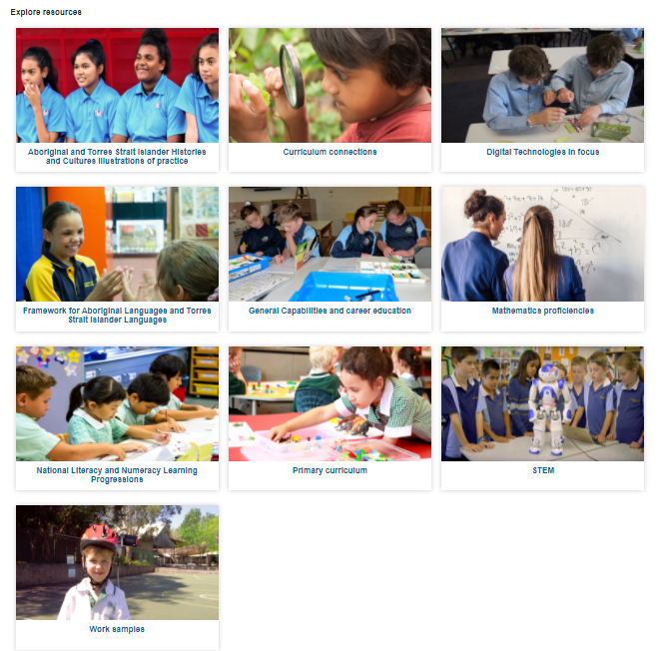
Australian Curriculum resources
Source: ACARA
Notes:
On the Australian Curriculum website, under the ‘Resources/publication’ tab, there is a link to the National Literacy and Numeracy Learning Progressions.
Clip source: www.australiancurriculum.edu.au/resources

Slide 6
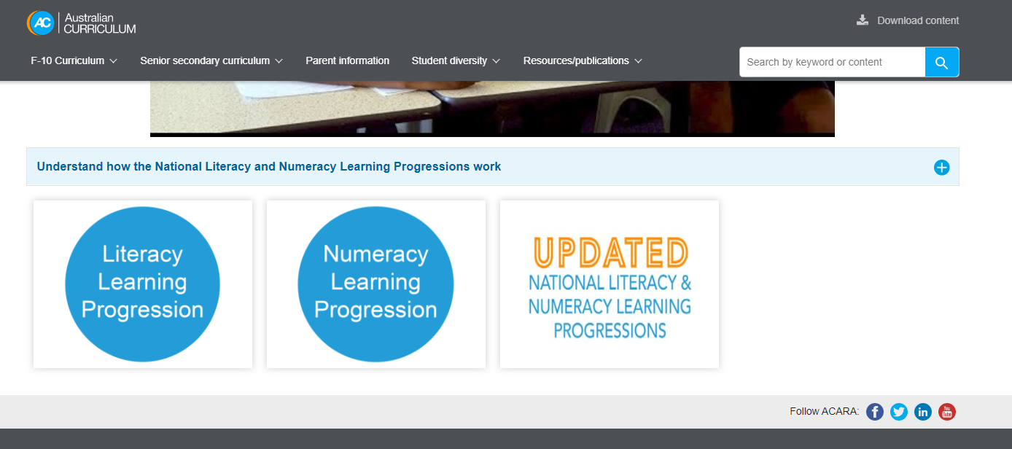
National Literacy and Numeracy Learning Progressions
Notes:
Clip source: https://australiancurriculum.edu.au/resources/national-literacy-and-numeracy-learning-progressions
On the National Literacy and Numeracy Learning Progressions page, you will find links to both Version 2 and the newly refined Version 3 of the progressions. This allows interested schools and jurisdictions to access Version 3 and also provides a transition time for those currently using Version 2 of the progressions.

Slide 7
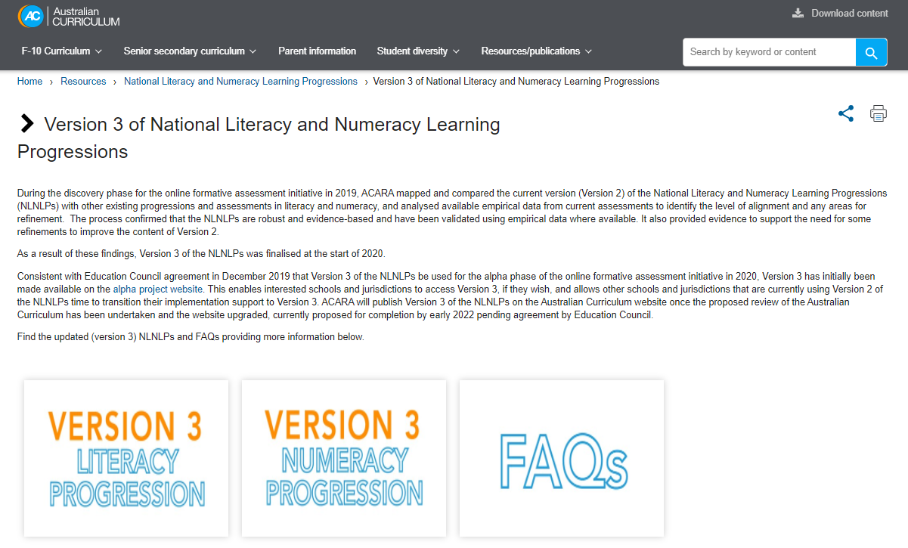
Version 3 of National Literacy and Numeracy Learning Progressions
Notes:
Clip source: www.australiancurriculum.edu.au/resources/national-literacy-and-numeracy-learning-progressions/version-3-of-national-literacy-and-numeracy-learning-progressions
Version 3 of the National Literacy and Numeracy Learning Progressions was finalised at the start of 2020 and is the basis of this presentation. The progressions are currently available on the Australian Curriculum site as PDFs. Once the Australian Curriculum review is finalised, Version 3 of the progressions is planned to be incorporated into the website upgrade.
A frequently asked questions document is also available for additional information.

Slide 8
Why the learning progressions were developed
The Education Council identified literacy and numeracy as areas for national action.
This included extending the national literacy and numeracy continua to:
… assist teachers to identify and address individual student needs according to the expected skills and growth in student learning at key progress points.
(Education Council 2015)
Notes:
The Education Council identified literacy and numeracy as areas for national action owing to their fundamental importance in a student’s learning and engagement in society. To enact this, the national literacy and numeracy continua were extended to … ‘assist teachers to identify and address individual student needs according to the expected skills and growth in student learning at key progress points’ (Education Council 2015).

Slide 9
The purpose of the progressions
The progressions:
provide a useful resource for targeted students
offer more fine-grained details of literacy and numeracy development than the general capabilities
provide a detailed map of how students become increasingly adept in particular aspects of literacy and numeracy
support teachers to be more explicit and targeted in their teaching.
Notes:
The National Literacy and Numeracy Learning Progressions provide a detailed map of how students progress in particular aspects of literacy and numeracy development.
They support teachers as they identify what a student knows, does, says or produces, and what steps to take next.

Slide 10
Progressions are a resource
The National Literacy and Numeracy Learning Progressions:
do not replace the curriculum
do not describe what to teach.
Notes:
The learning progressions are a resource, so they do not replace the curriculum or describe what to teach. They are used to support implementation of the curriculum learning areas.

Slide 11
Using the progressions
The progressions provide a tool to:
locate each student’s current level of literacy and numeracy development on the learning progression
identify the next steps for literacy and numeracy learning
develop a shared understanding of literacy and numeracy development.

Slide 12
Structure of the progressions
Elements
Sub-elements
Indicators
Levels
Notes:
There are common structural and organisational features in the Literacy and Numeracy Learning Progressions.
The largest structural unit is an element.
Each element is further divided into sub-elements.
Indicators describe each sub-element, and are grouped together to form developmental levels.

Slide 13
Elements
The elements in the progressions are the largest structural unit of literacy and numeracy development.
For literacy, the elements align to the modes of language use.
For numeracy, the elements reflect aspects of numeracy development.
Notes:
Literacy has three elements:
Speaking and listening
Reading and viewing
Writing.
Numeracy has three elements:
Number sense and algebra
Measurement and geometry
Statistics and probability.

Slide 14
Sub-elements
Each element includes sub-elements that represent important components of knowledge, understanding and skills.
Notes:
There are five holistic sub-elements of literacy development and these are supported by seven other sub-elements. These are the evidence-based aspects of literacy.
Numeracy has 14 sub-elements, which are important aspects of numeracy capability.

Slide 15
Indicators
The sub-elements are populated by indicators, which describe how students demonstrate literacy and numeracy skills.
The indicators are grouped together to form developmental levels. These indicators are not hierarchical.
Each indicator begins with ‘A student …’
Notes:
The sub-elements are populated by indicators.

Slide 16
Levels
The levels in each sub-element represent a group of indicators that describe what a student knows, says, does and produces.
Each level is more complex and sophisticated than the preceding level.

Slide 17
Maximising the benefits of the progressions
A whole-school, systematic approach to literacy and numeracy development should ensure:
teacher understanding of literacy and numeracy development
capacity to locate the literacy and numeracy development of targeted students
information about students’ literacy and numeracy progress.

Slide 18
Student diversity and the progressions
The progressions help teachers cater for diverse learners by acknowledging differences in starting points and rates of progression.
The progressions also acknowledge that teachers should be supported to differentiate for students at all stages of schooling.
Notes:
In summary, the Literacy and Numeracy Learning Progressions support learners by recognising that:
students’ progress at different rates through the levels and across the elements
students demonstrate literacy skills in different ways at the initial levels
some students use augmentative and alternative communication strategies to demonstrate literacy and numeracy skills
students are starting from different points in their literacy and numeracy learning development
teachers need to differentiate for students at all stages of schooling.

Slide 19
Where to now?
QCAA advises that the National Literacy and Numeracy Learning Progressions are a resource schools may choose to use.
Schools are best placed to decide how to use the progressions, with advice from their sector.
The National Literacy and Numeracy Learning Progressions are on the Australian Curriculum website under the ‘Resources/publications’ tab:
https://australiancurriculum.edu.au/resources/national-literacy-and-numeracy-learning-progressions

Slide 20

Acknowledgments
© State of Queensland (QCAA) 2020
Licence: https://creativecommons.org/licenses/by/4.0 | Copyright notice: www.qcaa.qld.edu.au/copyright — lists the full terms and conditions, which specify certain exceptions to the licence. |
Attribution: ‘© State of Queensland (QCAA) 2020— please include the link to our copyright notice.
Other copyright material in this publication is listed below:
With the exception of photographs, content from ACARA, including the National Numeracy Learning Progression, is © ACARA 2010–2020, licensed under CC BY 4.0. For the latest information and additional terms of use, please check the Australian Curriculum website and its copyright notice.
Photographs from ACARA are excluded from the CC BY licence and may only be used in unaltered form only for your personal, non-commercial educational purposes or for the non-commercial educational purposes of your organization.
Education Council (2015) as cited in the National Literacy and Numeracy Learning Progression.

