Slide 1
Information for school staff
Queensland Certificate of Individual Achievement
14733
Notes:
This presentation will provide school staff with information about how Queensland recognises the educational achievements of young people who have highly individualised learning programs.

Slide 2
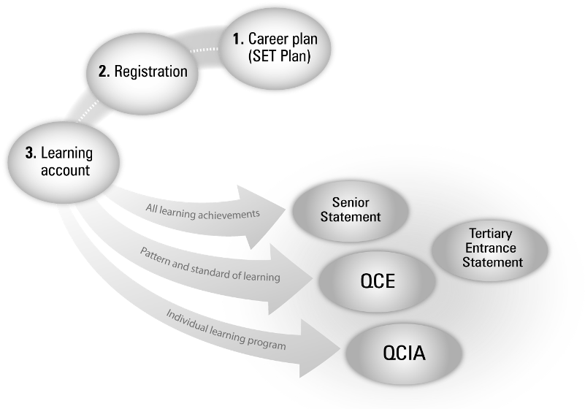
The senior phase of learning
Notes:
The planning process:
Planning — what, where and when to study, and usually by the end of Year 10
Develop a SET Plan
Registering
Opening a learning account
Recognising and recording student achievement/outcomes Senior Education profile (SEP) components:
QCE — The Queensland Certificate of Education is awarded to eligible students, usually at the end of Year 12. Students must have at least 20 credits in the required pattern, and fulfil literacy and numeracy requirements.
Senior Statement — This is a transcript of the learning account for all students completing Year 12 at a school. It shows all studies that may contribute towards the award of a QCE and the results achieved.
Tertiary Entrance Statement — This shows the eligible student’s Overall Position (OP) and Field Positions (FPs). Rankings are used to determine eligibility for admission to tertiary courses.
QCIA — This certifies achievements by students with special learning needs undertaking individualised learning programs.

Slide 3
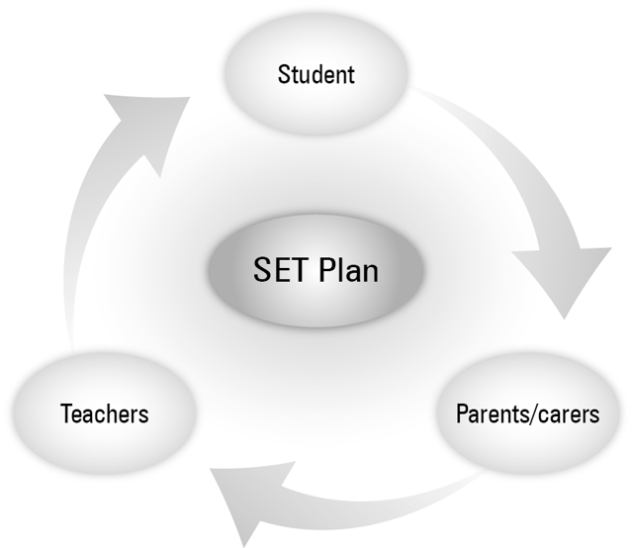
The planning process–SET Plan
Notes:
3
A student’s senior learning program is not an ad-hoc process of simply accumulating sufficient credits to be awarded a QCE.
Year 10 is a foundation year for the Senior Phase of Learning to consolidate the knowledge, skills and capabilities that are necessary for successful learning in Years 11 and 12.
To assist in building this foundation, all Year 10 students have the opportunity to develop Senior Education and Training Plans with their school and parents/carers. The Senior Education and Training Plan maps out a student's plan of action for his or her education and training through the Senior Phase of Learning.
A SET plan should involve, and have the agreement of, the student, their parents/carers and the school/learning provider.

Slide 4
Certificate overview
The Queensland Certificate of Individual Achievement (QCIA) recognises the learning achievements of students who undertake individualised learning programs. The QCIA is:
an official record that students have completed at least 12 years of education
a summary of their knowledge and skills that they may present to employers or training providers.
Notes:
The QCIA reports on the achievements of students on individualised learning programs and who generally are unable to engage in accredited programs.
The QCIA is an Australian certificate of education recognised by the responsible state and territory ministers of education. It meets the Australian Qualifications Framework requirements of a senior secondary certificate of education. It is issued by the QCAA.
The certificate arose from concerns that some students with special needs did not receive a Senior Certificate, or received one that showed little about their achievements.

Slide 5
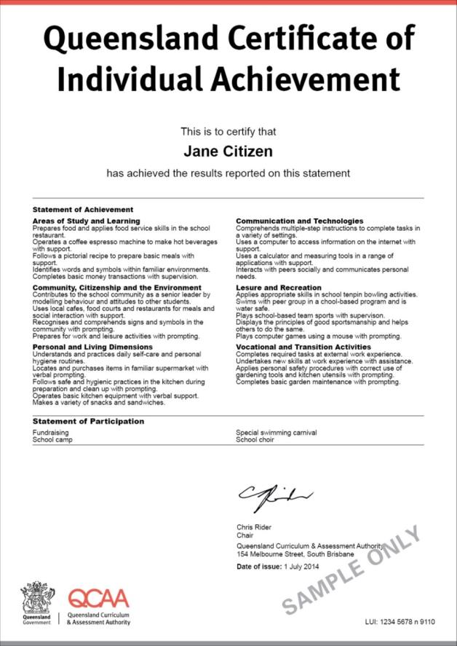
Certificate format
Notes:
The QCIA adds to the suite of certificates that the QCAA issues and ensures that the educational achievements of all students can be recorded and certificated.

Slide 6
Documents posted to students
QCIA
Senior Statement
Application for verification or review of information
Student Connect magazine
QCIA factsheet
Notes:
At the end of Year 12, students receive an A4 envelope containing:
QCIA
Senior Statement
Application for verification or review of information
Student Connect magazine
QCIA factsheet
All students receive a Senior Statement. However, some QCIA students may not have any recorded achievements in their learning accounts and this statement may have no recorded learning and a statement indicating there is no achievements at this point in time.
Student Connect is a magazine for Year 12 students that contains information about their senior study and future learning and career pathways.
The QCIA factsheet has specific information about future options.

Slide 7
Other documentation posted with the QCIA
An Application for verification or review of information on the QCIA is included in the envelope posted to students.
This form is only used if there is an error in the student’s name or certificate information.
A sample of this form may be found in the QCIA Handbook and on the website.
Notes:
All certificates are posted to students with an Application for verification or review of information on the QCIA.
This form is only used if there is an error in the student’s name or certificate information.
A payment must accompany all applications.

Slide 8
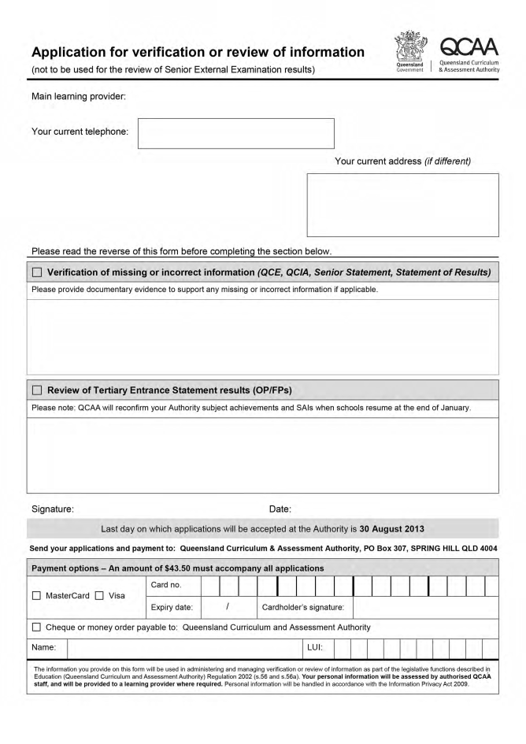
Indicate here for QCIA
Notes:
A sample of this form may be found in the QCIA Handbook. On the QCAA website (www.qcaa.qld.edu.au), go to Senior Secondary > Certificates & qualifications > Queensland Certificate of Individual Achievement > Teacher guides and resources > Handbook.

Slide 9
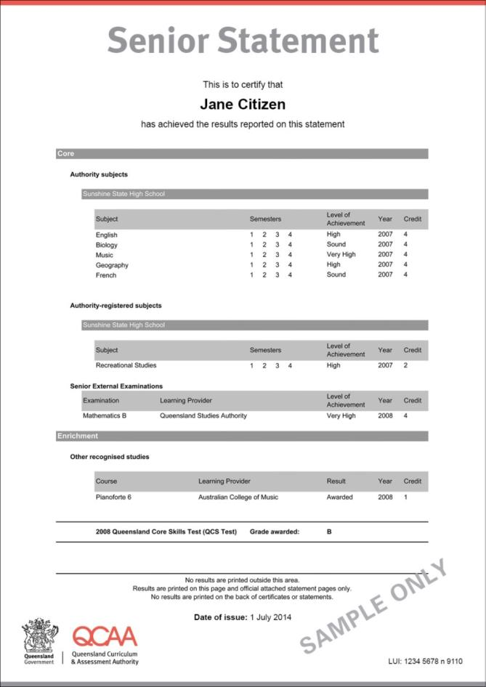
Notes:
QCIA learning is NOT included on this statement.

Slide 10
Senior Statement
Legislation requires that students who finished Year 12 will receive a Senior Statement, regardless of whether they have met the requirements for the award of a QCE at that time.
This statement is a transcript of the learning account that records QCE-contributing studies and the results achieved.
Notes:
The Senior Statement is a transcript of the learning account, recording all QCE contributing studies undertaken and the results achieved.
Students who complete Year 12 will receive a Senior Statement.
It states whether the student has been awarded a QCE, if they are eligible.

Slide 11
Who is eligible to receive the QCIA?
Students who:
are nominated by the principal of the school
undertake studies that are part of an individualised learning program
have an impairment or difficulties in learning that are not primarily due to socioeconomic, cultural and/or linguistic factors
have at least 12 years of schooling
are enrolled at school until the date specified as the end of Year 12.
Notes:
Schools identify eligible students. Consultation with students and their parents/carers is important to this decision-making process. Students should be identified at the beginning of their senior phase of learning.
Students must be undertaking studies that are part of an individualised learning program and have an impairment or learning difficulties that are not primarily due to socioeconomic, cultural and/or linguistic factors.

Slide 12
What achievements are included on this certificate?
The QCIA contributing studies are:
Statement of Achievement
Statement of Participation.
Statements of Achievement are subject to guidelines and quality processes defined by the QCAA.
Notes:
Unlike the QCE, the QCIA has only two contributing studies. These studies do not contribute towards the QCE.

Slide 13
Statement of Achievement
Free-form text statements of demonstrated knowledge and skill
Holistic picture of demonstrated knowledge and skill
Written in a standard format
Achievements shown under six curriculum organisers or categories
Schools choose all or some of the six curriculum organisers or categories
Notes:
The aim of the Statement of Achievement is to create a complete picture of the student’s demonstrated educational achievement under categories called ‘curriculum organisers’.

Slide 14
Statement of Achievement
The six curriculum organisers or categories are:
Areas of study and learning (ASL)
Communication and technologies (CT)
Community, citizenship and the environment (CCE)
Leisure and recreation (LR)
Personal and living dimensions (PLD)
Vocational and transition activities (VTA)
Notes:
The school chooses some or all of the organisers according to a student’s learning program.

Slide 15
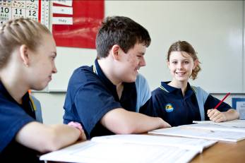
Areas of study and learning (ASL)
This section could include information about:
performance in specific programs e.g., literacy and numeracy
broad areas of learning that the school identifies and develops to meet the educational needs of the student.
Notes:
Some students study specific learning programs that might be fully school developed for the individual student or groups of students within a school. It could also be that some students participate in Authority and Authority-registered subject classes, working on modified or personal goals and assessment. These may be the knowledge or skills that would be captured in comments around this organiser.
Equally, it could be the case that there are not any clearly defined learning programs, but rather a single program that covers a number of areas.

Slide 16
Communication and technologies (CT)
This section could include information about:
Communication performance in language, literacy and numeracy
the use of adaptive and augmentative devices across calculation, reading, writing, listening, speaking or speech equivalent
the use of computer and communication technologies.
Notes:
Communication is fundamental to almost all aspects of students’ education. It may be covered through other courses and activities.
Students gain knowledge and skills in literacy and digital technologies.
Communication involves the student learning to comprehend language in listening, reading and viewing and to use language to communicate with others through speaking, writing and creating.
Technologies involves the student learning to operate devices, including those for listening, reading, viewing, speaking or speech equivalent, writing and creating language and texts, and calculation. They learn technical and social protocols for safe use of digital technologies to interact with others.
For many students, the technologies that they are most likely to interact with will be communication technologies, either in specialist forms such as speech processors or in the more commonly encountered forms such as PCs, DVDs, or mobile phones.

Slide 17
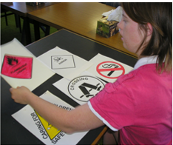
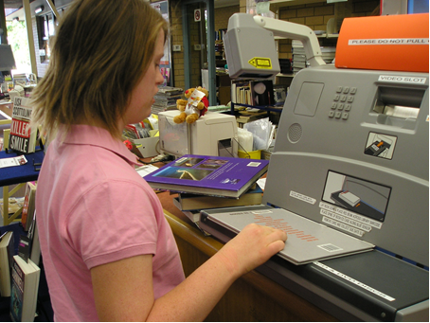
Community, citizenship and the environment (CCE)
This section could include information about:
involvement in, and contribution to, the local and wider community
activities that focus on the environment
accessing and using community facilities.
Notes:
Students learn to participate as active citizens who contribute to their local and wider community. They learn about similarities and differences between the present and the past, explore and investigate the natural and constructed features of places and make observations about the environment and world around them.
This organiser could include work on a school-based recycling program or accessing local community facilities. It could also include understandings about rights and responsibilities.

Slide 18
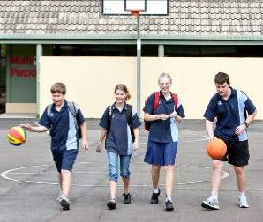
Leisure and recreation (LR)
This section could include information about:
performance in activities, such as competitive individual and team sports, outdoor pursuits, and fitness and physical development programs
the use of school-based leisure time in active and constructive ways.
Notes:
Students learn to experience and participate in a variety of leisure and recreation activities.
They learn about different physical activities and the importance of lifelong physical activity.
They learn to make, participate, perform, contribute to and express opinions as audience members for artistic and cultural activities that include dance, drama, music, media arts and/or visual arts.
They learn to identify, experience and participate in their own preferred leisure and recreation activities.

Slide 19
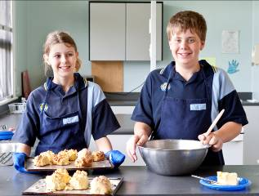
Personal and living dimensions (PLD)
This section could include information about:
personal development and management, goal setting, decision making, budgeting and community mobility
health, nutrition, interpersonal skills and independent- and cooperative-living skills.
Notes:
Students learn about their own and others’ identity, health and wellbeing, and understandings and skills for living independently and interdependently.
They explore and take actions to keep themselves and their peers healthy and safe through food and nutrition, safe use of medicines and ways to keep safe in the environment.
They learn about emotions, how to enhance their interactions and relationships with others, and the physical and social changes they go through as they get older.
They develop their ability to use numeracy skills in everyday situations, and set goals and make decisions to achieve them.
Care is needed to ensure that some Individual Education Program (IEP) goals of highly personal matters are not reported in this organiser as “skill or knowledge” achievements. They may not be appropriate for a senior certificate with a general audience.

Slide 20
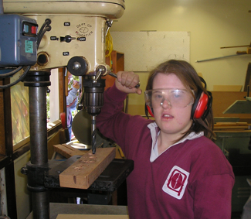
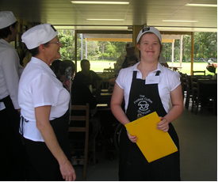
Vocational and transition activities (VTA)
This section could include information about:
performance in vocational and work-oriented activities undertaken in school-based courses
accessing local and community resources for planning life pathways and post-school options.
Notes:
Students identify, learn about and investigate their post-school pathways.
They develop specific knowledge and skills to support their transition pathway to life beyond school through school-based courses, enterprise and/or vocational activities set in contexts relevant to them.
They learn about local and community resources, and how to access them to support their needs when they transition to life beyond school.
The area of Vocational and transition activities has had some predominance in post-school options investigations and activities for students.
Any modules or competencies of vocational education and training (VET) certificate qualifications, and core or preparatory learning areas of the QCE, will be recorded on the Senior Statement and should not be duplicated here.

Slide 21
Writing Statements of Achievement
Free-format text follows writing conventions.
Include a maximum of 5 to 6 statements per curriculum organiser.
Do not use lengthy sentences.
Use plain language.
Refer to the QCIA Handbook for guidelines.
Refer to the website Comment database for statements.
Notes:
The QCIA Handbook provides comprehensive guidelines for writing the free-form statements. Schools must adhere to the conventions for the structure of the statement, and also follow the statement criteria that are listed.
More information on this process and the necessary forms are available in the handbook.

Slide 22
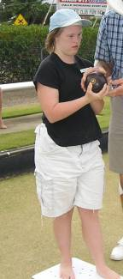
Statement of Participation
Includes the names or titles of activities students have undertaken
May include community-based learning, extra-curricula activities, work experience, enrichment programs or community-access programs
Have no provision for explanation of the activity.
Notes:
The Statement of Participation is an extensive list of the many activities that schools have available for their students. There is no indication of the nature of any achievements or standards for the activity. The list is found in the QCIA Handbook.

Slide 23
QCIA eligibility processes
Schools:
identify eligible students
consult with students and their parents/carers
indicate eligibility for the QCIA through the Student Data Capture System (SDCS)
identify the QCIA as an ILO in SLIMS
communicate eligibility to QCAA using the eligibility form and curriculum plan.
Notes:
To download the form, go to the QCIA home page on the QCAA website, then click QCIA teacher guides and resources.

Slide 24
Eligibility form and curriculum plan procedures
Download the form from the QCAA website at www.qcaa.qld.edu.au/2647.html
Complete a plan for each student
Sample curriculum plans are available on the QCAA website
Ensure the principal signs the form
Retain a copy and send original to the QCAA.
Notes:
Learning programs and learning outcomes are designed to meet the learning needs of the student.
Access the Word document template for each student and save with an identifier for that student. Information about the learning programs may be entered electronically.
Complete the three sections of the form:
School and student details
Student individual learning program and intended learning outcomes in the relevant curriculum organiser.
School self-checklist to confirm QCIA eligibility
Ensure that the school principal signs the original copy and all sections are completed, especially the QCIA school contact person and details sections. The school must keep a copy of the document. However, the original is scanned and emailed to QCAA.

Slide 25
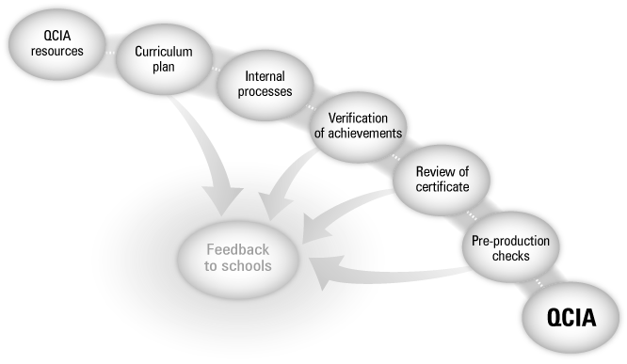
Quality-assurance processes
Notes:
As part of the QCIA quality-assurance processes, schools:
complete the eligibility form and curriculum plan for each student and submit to the QCAA
prepare draft certificate information and evidence
attend a verification meeting with this information in August of the exit year.

Slide 26
Quality-assurance processes
Eligibility form and curriculum plan (May)
Internal school processes
District verification meetings to review draft certificates and evidence (August)
State review of provisional certificates (October)
Pre-production checks (November)
Notes:
To ensure that the QCIA meets the Australasian Curriculum, Assessment and Certification Authorities (ACACA) principles, a number of quality-assurance procedures need to occur. These are support for schools and teachers, internal school processes, the curriculum plan, peer moderation at the district and state meetings, and other internal QCAA processes.

Slide 27
Internal school processes
What currently occurs in your school?
What improvements could be made or alternative processes used?
Schools must keep evidence of achievement to substantiate the certificate statements of achievement.
How is this information/evidence stored?
How do you ensure that there is accurate data submitted to the QCAA?
Notes:
Schools need to consider the best ways to collate and present the student evidence for the Statements of Achievement that will be used on the student’s certificate.
A student portfolio organised in the six curriculum organiser areas greatly assists the verification process at the district meetings held in August each year.
Evidence showing the Statement of Participation activities must also be included in the portfolio.

Slide 28
Validation of certificate information
District verification:
involves the peer review of:
draft certificate information
samples of evidence to support the Statement of Achievement
the match between the intended learning outcomes and the Statement of Achievement
is held in August of the exit year
is mandatory for all schools with exiting students
provides feedback to schools.
Notes:
In July, a QCAA memo to schools provides information about the August verification meetings. The main focus of this meeting is to review the draft certificate information and provide feedback and support to schools. Teaching colleagues look at the student sample of evidence used to make judgments about the educational achievements of that student.
More information on this process is available in the QCIA Handbook.

Slide 29
Draft QCIA for verification
The draft QCIA achievements are entered in SLIMS — RABS.
The Statement of Achievement comments database is incorporated in SLIMS — RABS.
Check the QCAA website at www.qcaa.qld.edu.au/1161.html for the SLIMS and QCIA data user guide .
Notes:
Refer to the PowerPoint presentation, Preparing for verification for more detailed information on this process.

Slide 30
Entering statements in SLIMS — RABS
Statements of Achievement may be entered by:
either selecting a statement from the comments database
or adding your own free-form text statement that reflects the achievement of the student.
Statements of Participation are:
selected from a “pick list”
not able to be entered manually.

Slide 31
Folio of evidence of achievement
This evidence:
matches the intended learning outcomes outlined in the curriculum plan
is collected for all nominated eligible students
is used to substantiate the final certificate information
is best organised in the curriculum organisers
uses a variety of evidence, e.g. checklists, photographs, learning logs.
Notes:
Schools collect evidence of achievement throughout the student’s senior schooling phase. This evidence from the intended learning outcomes outlined in a student’s curriculum plan is used to substantiate the final certificate information in the student’s exiting year. Evidence is collected for all students.

Slide 32
Evidence of achievement
Legislation states students are entitled to query the results on their certificates.
Evidence of achievement must be kept for:
verification of certificate information at district meetings
response to any student queries to verify certificate information
one term after the students have been issued their certificates.
Notes:
A QCAA memo alerts schools to the date of retention for Year 12 exiting students’ work.

Slide 33
State review processes
In October of the exit year, district advisers review:
certificate information submitted by the school in the SLIMS — Registration and banking to QCAA
information for all sections of the certificate
duplication issues and the quality of written statements.
Feedback and advice is provided to schools.
Notes:
The State Review Processes are the second phase of the moderation process. It occurs on the pupil-free day in October. Schools must ensure they meet the timelines when submitting the certificate information downloaded into SDCS. The district advisers and officers of the QCAA review the certificate information. Feedback and advice are provided to schools.
More information on this process is available in the QCIA Handbook.

Slide 34
Pre-production checks
In December of the exit year, QCAA staff:
check the final certificate information submitted by schools through SLIMS–RABS
proofread certificate information
check the printed certificates before posting.
Notes:
Final pre-production certificate checks occur when schools have submitted all certificate information through the SLIMS–RABS. Officers of the QCAA check all certificate data for formatting and errors.
Once certificates have been printed, all certificates are hand-checked for errors and misprinting before they are posted.

Slide 35
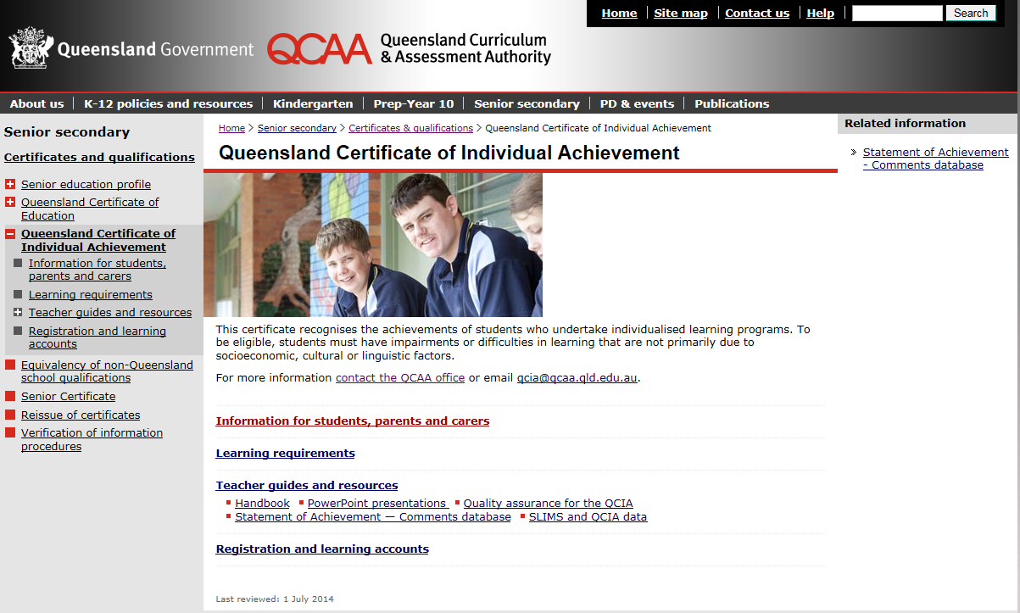
Where to find QCIA information
Notes:
To access a sample certificate and the QCIA brochure, go to the QCAA website and click on Years 10–12 > Queensland Certificate of Individual Achievement > Information for students, parents and carers. The related information link on the right-hand side provides an update about what is happening with the certificate processes.

Slide 36
More information
QCAA’s website: www.qcaa.qld.edu.au
Email: qcia@qcaa.qld.edu.au
Direct link to QCIA information: www.qcaa.qld.edu.au > Senior Secondary > Certificates & qualifications > Queensland Certificate of Individual Achievement
Direct link to QCE information: www.qcaa.qld.edu.au> Senior Secondary > Certificates & qualifications > Queensland Certificate of Education

