Slide 1
Your QCE

Slide 2
Overview
What the Queensland Certificate of Education (QCE) represents
How you can tailor your studies to best suit your talents and interests, and create a pathway to preferred school outcomes
What options are available?

Slide 3
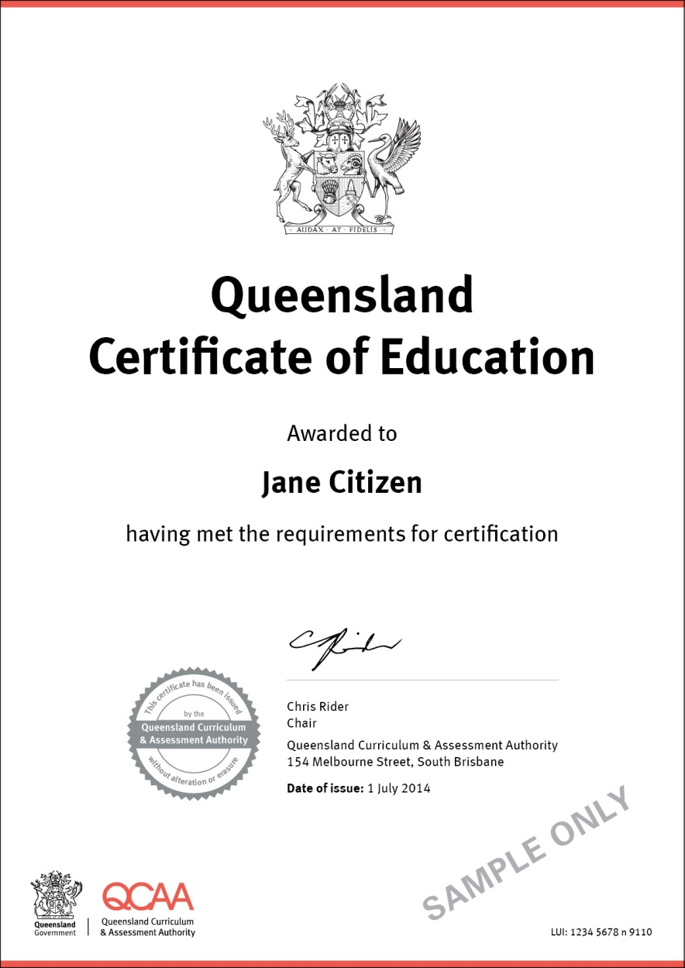
What is the QCE?
Queensland’s senior school qualification is:
internationally recognised
achievement based
flexible ― letting you choose what, where and when you study.

Slide 4
What is the QCE?
Awarded when you meet the set requirements
Recognises your achievements in Years 11 and 12
Shows employers and training providers that you have worked consistently and to a high standard
May be required to enrol in further education and training in Queensland, interstate and overseas

Slide 5
What can I study?
QCE learning options suit your strengths, interests and goals:
school subjects
vocational education and training (VET)
school-based apprenticeships (SBA) and traineeships (SBT)
learning projects
recognised studies
TAFE advanced diploma or diploma modules
university studies.

Slide 6
School subjects
Authority subjects are based on syllabuses that have been approved and issued by the Queensland Curriculum and Assessment Authority (QCAA).
Results in Authority subjects can count in the calculation of OP and FPs — commonly used for tertiary entrance.

Slide 7
School subjects
Authority-registered subjects are developed from Subject Area Syllabuses (SASs) and generally include substantial vocational and practical components.
Results in these subjects are not used in the calculation of OPs and FPs.

Slide 8
Recognised studies
Courses of learning include:
awards and certificates
international learning programs, e.g. International Baccalaureate Diploma program
school-based courses
structured community and workplace learning
Not based on QCAA syllabuses or VET qualifications
Can contribute credits towards your QCE

Slide 9
Learning projects
Independent and unique short program of learning
Structured work-based, community-based or self-directed learning
Separate from any established school, training or other educational program
Can contribute towards your QCE

Slide 10
University subjects and diploma modules
Most Queensland universities and TAFEs offer Years 11 and 12 students the opportunity to study at tertiary level.
If you complete an advanced diploma or diploma module or university subject while at school, you can earn credits towards your QCE.

Slide 11
Apprenticeships and traineeships
A school-based apprenticeship or traineeship provides the opportunity to train on the job while working towards the QCE.

Slide 12
How do you choose what to study?
Your Senior Education and Training (SET) plan
Your teachers/career guidance officers and parents/carers will help you decide which learning options are best for you — to ensure you achieve your learning and career goals.

Slide 13
Career exploration
myfuture
www.myfuture.edu.au
The Real Game
www.realgame.esa.edu.au

Slide 14
You need
20 credits
at a set standard
Sound Level of Achievement, Pass or equivalent
in a set pattern
at least 12 credits from completed Core courses of study plus an additional 8 credits from a combination of any courses of study
but a maximum of 6 credits from Preparatory courses of study
and meet literacy and numeracy requirements
To gain a QCE

Slide 15
A set standard
To get credits for a course of study you have to meet a minimum standard for that study, e.g. Sound Achievement, Pass, Competent — depending on the course’s type of assessment grade.

Slide 16
Categories of learning
Courses of study for the QCE are organised into four categories:
Core
Preparatory
Advanced
Enrichment

Slide 17
A set pattern
A total of 12 credits must come from completed Core courses of study
Completed Core can be met through the study of:
4 semesters of school-based subjects at a Sound Level of Achievement (SA) or higher
Completed VET Certificates II, III or IV
Satisfactory participation in the on-the-job component of school-based apprenticeship (50 days in a calendar year)
A total of 8 credits can come from other courses of study

Slide 18
Core courses of study
Includes:
authority and authority-registered subjects
VET Certificates II, III and IV
school-based apprenticeships or traineeships
To get your QCE, you must achieve at least 12 credits from completed Core courses of study
At least one credit must come from a Core course while enrolled at school
Partial completion of a Core course of study may contribute some credit towards your QCE

Slide 19
Preparatory courses
Includes VET Certificate I qualifications and some recognised certificates and awards
Can be used as a stepping stone to further study or training
A maximum of six credits from Preparatory courses can count towards your QCE
Only two Certificate I qualifications can be used to gain credit towards your QCE

Slide 20
Enrichment courses
Provide you with opportunity to develop your skills and knowledge at a higher level
Often offered by community organisations other than those offering Core or Preparatory courses of study
A maximum of 8 credits from Enrichment courses can count towards your QCE

Slide 21
Advanced courses
Go beyond the normal range of typical senior schooling
Includes university courses, diplomas and advanced diplomas undertaken while enrolled at school
A maximum of 8 credits from Advanced courses can count towards your QCE

Slide 22
Literacy requirement
Sound Achievement in one semester of these QCAA subjects:
English
English Extension
English Communication
English for ESL learners
Sound Achievement in English assessed by Senior External Examination
Sound Achievement in the QCAA short course in literacy

Slide 23
Literacy requirement (continued)
Completion of Certificate I in Core Skills for Employment and Training - Communication (39282QLD), Certificate II in Core Skills for Employment and Training - Communication (39283QLD) or Certificate II in Skills for Work and Vocational Pathways (FSK20113)
Pass in literacy course recognised the QCAA
C or above in the QCS Test
4 or above for an International Baccalaureate (IB) examination in Language A English Language and Literature (SL or HL) or Language A English Literature (SL or HL)

Slide 24
Numeracy requirement
Sound Achievement in one semester of these QCAA subjects:
Maths A
Maths B
Maths C
Pre-vocational Maths
Sound Achievement in Maths A or Maths B assessed by a Senior External Examination
Sound in the QCAA short course in numeracy

Slide 25
Numeracy requirement (continued)
Completion of the Certificate I in Core Skills for Employment and Training — Numeracy (39288QLD), Certificate II in Core Skills for Employment and Training — Numeracy (39289QLD), or Certificate II in Skills for Work and Vocational Pathways (FSK20113)
Pass in a QCAA-recognised numeracy course
C or above in the QCS Test
4 or above for an International Baccalaureate (IB) examination in Mathematics (SL or HL) or Mathematics Studies (SL)

Slide 26
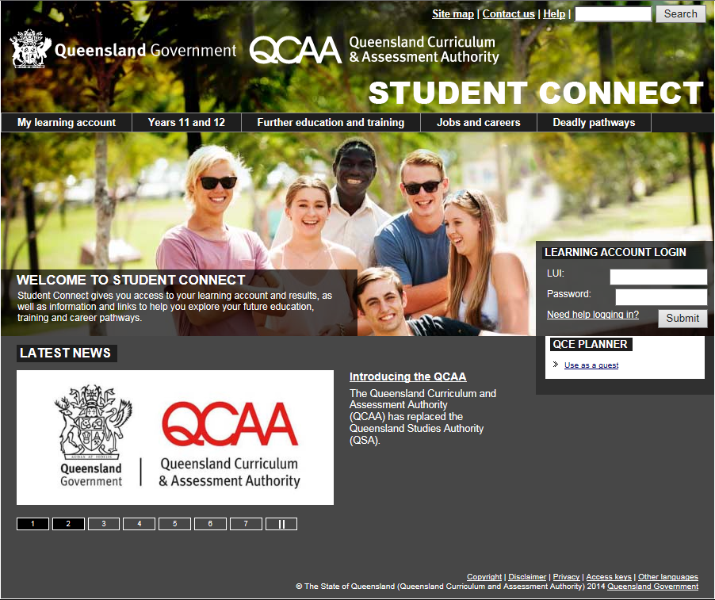
Tracking your progress
Track your progress towards a QCE in your learning account on the Student Connect website.
www.studentconnect.qcaa.qld.edu.au

Slide 27
When will I get my QCE?
The QCE is awarded when you meet the set requirements for a QCE — usually at the end of Year 12.
If you leave school earlier or do not achieve a QCE by the end of Year 12, you can keep working towards it for seven years after you have (or would have) completed Year 12.

Slide 28
Find out more
Student Connect
www.studentconnect.qcaa.qld.edu.au
Queensland Curriculum and Assessment Authority
www.qcaa.qld.edu.au
Talk to your teachers/career guidance officer at your school

